Slide 1
If/Else Statements & For Loops

Slide 2
Boolean Expressions
Boolean expressions: expressions that are either true or false
Commands: use ==, != , > , < , >= , or <= to compare two expressions.

Slide 3
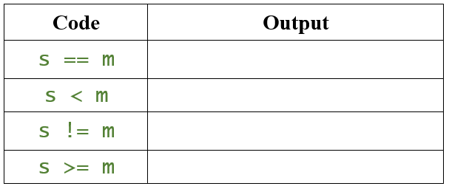
Example 1: Suppose you defined the following vectors:
                s <- 5
                m <- 5
What are the outputs if I ran the following lines of codes?

Slide 4
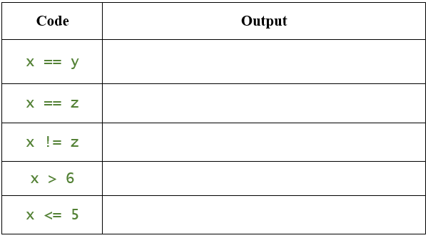
Example 2: Suppose you defined the following vectors:
        x <- c(4,5,6,7)
        y <- 4:7
        z <- c(4, 5, 7, 9)
What are the outputs if I ran the following lines of codes?

Slide 5
Conditional Statements
If Statements
The “if” statement allows you to execute a block of code only if a given condition is true.

Slide 6
Example 3: What is the output when you run this code?
sky <- "sunny"
if (sky == "sunny"){
print("Leave your umbrella at home!")
}
Output:
What is the output when you change the first line to sky <- “cloudy”?
Output:

Slide 7
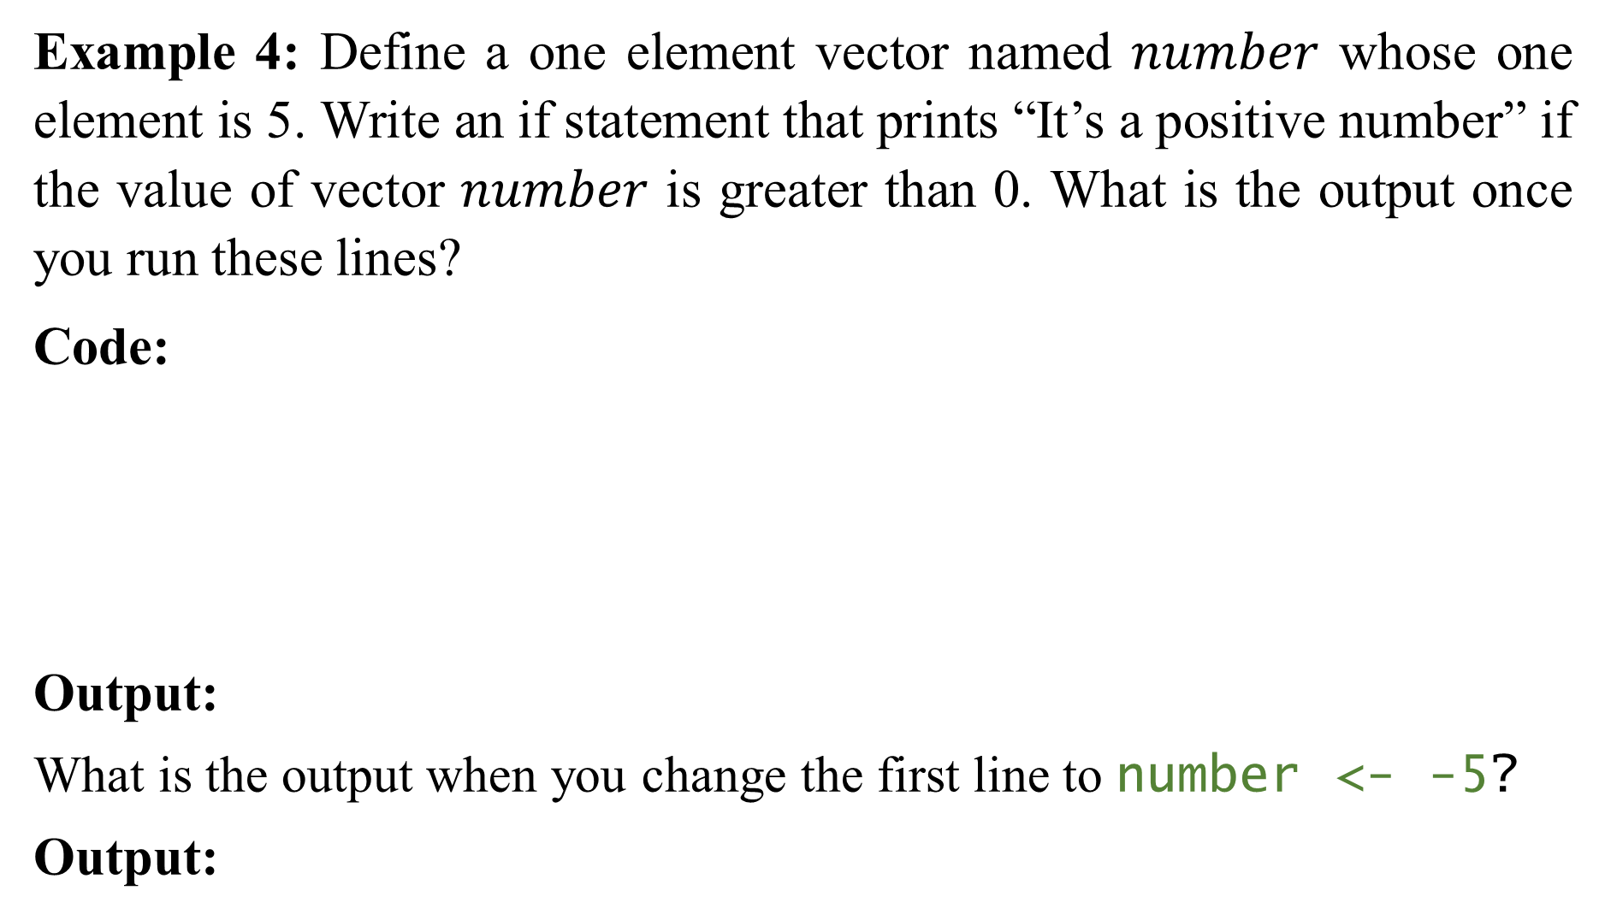
Example 4: Define a one element vector named $number$ whose one element is 5. Write an if statement that prints “It’s a positive number” if the value of vector $number$ is greater than 0. What is the output once you run these lines?
Code:
Output:
What is the output when you change the first line to number <- -5?
Output:

Slide 8
If-Else Statements
The “if else” statement extends the “if” statement to execute different blocks of code based on whether a condition is true or false.

Slide 9
Example 5: What is the output when you run this code?
number <- -3
if (number > 0) {
print("The number is positive.")
} else if (number < 0) {
print("The number is negative.")
} else {
print("The number is zero.")
}
Output:

Slide 10
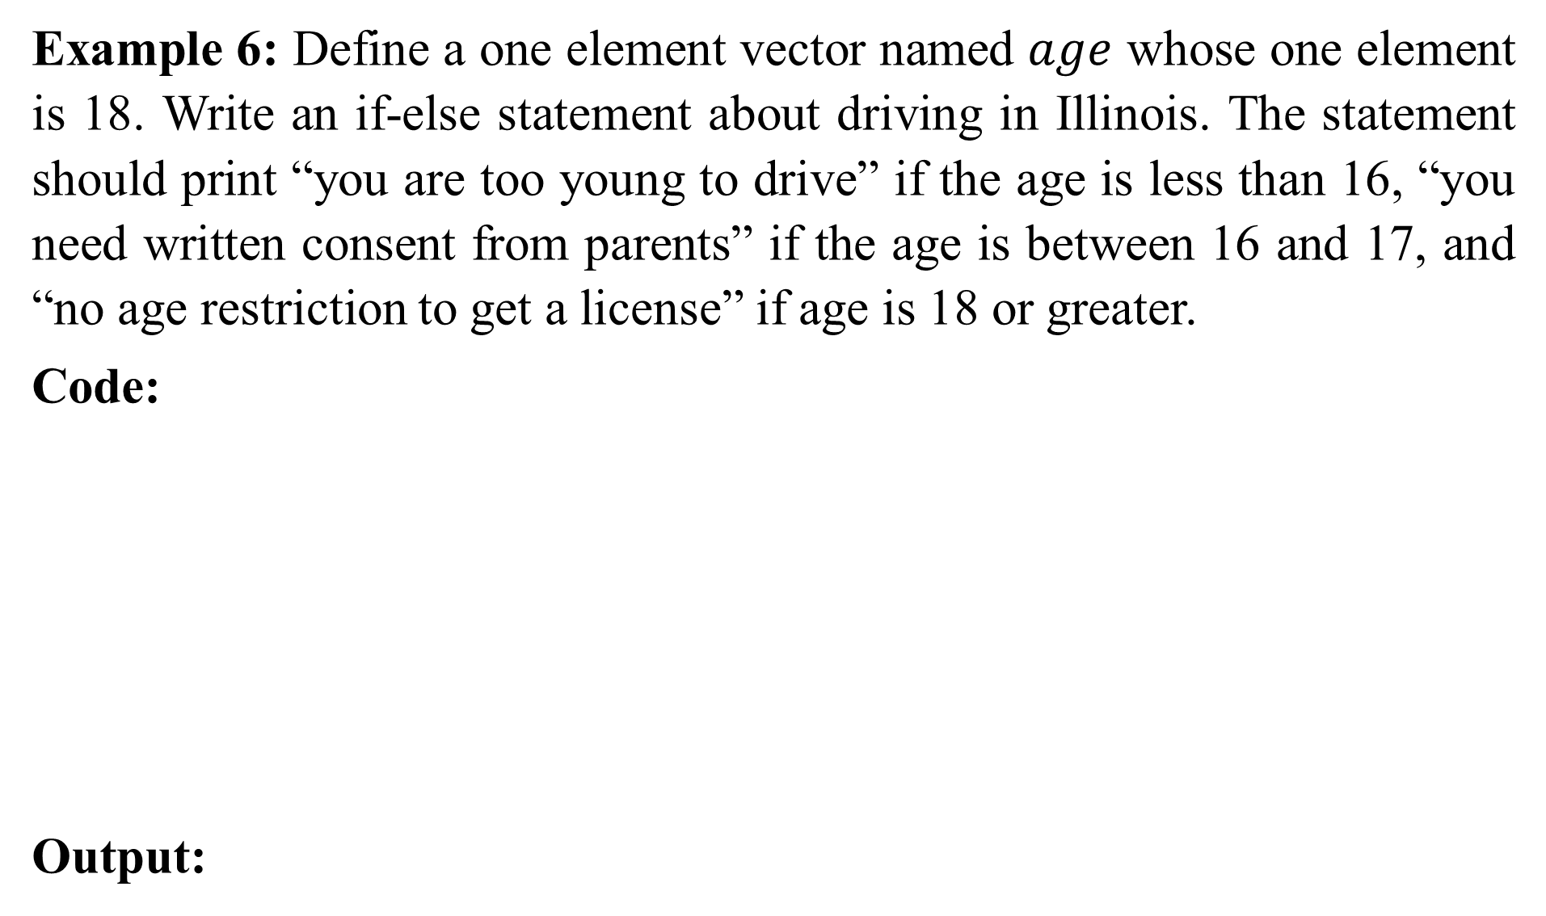
Example 6: Define a one element vector named $age$ whose one element is 18. Write an if-else statement about driving in Illinois. The statement should print “you are too young to drive” if the age is less than 16, “you need written consent from parents” if the age is between 16 and 17, and “no age restriction to get a license” if age is 18 or greater.
Code:
Output:

Slide 11
Ifelse Function
This is for when you want to use if else statements repeatedly to return a vector.
Example 7: What is the output when you run this code?
numbers <- c(-2, 3, 0, -5, 7)
positive_indicator<-ifelse(numbers>0, "Positive", "Not Positive")
numbers
positive_indicator
Output:

Slide 12
Example 8: Define a vector named numbers_2 with elements 5, -2, 0. Then define a new vector named eval_5 using the ifelse function that tells you whether the numbers in numbers_2 are greater or equal to 5 or smaller than 5.
Code:
Output:

Slide 13
For Loops
The basic structure of a for loop looks like this:
for (variable in sequence) {
code to be executed in each iteration
}

Slide 14
Example 9: What is the output when you run this code?
for (i in 1:5){
print(i)
}
Output:

Slide 15
Example 10: What is the output when you run this code?
for (i in c(2, 3, 5)){
print(i+1)
}
Output:

Slide 16
Example 11: What is the output when you run this code?
for (i in c("Mike", "Mary", "Tom")){
print(paste(i, "works at Loyola", sep = " - "))
}
Output:

Slide 17
Example 12: Create a character vector called student_names that contains the elements “Rohan”, “Ana”, and “Amir”. The create a for loop to print the following information:
                Student 1 is Rohan
                Student 2 is Ana
                Student 3 is Amir
Code:
Output:

Slide 18
Example 13: Doing computations with for loops. What is the output when you run this code?
x <- matrix(c(9, 0, 3, 17, 5, 2), ncol = 3, byrow = FALSE)
y<-NA
for(i in 1:3){
y[i] <- mean(x[,i])
}
y
Output:

